Slide 1
CSA1012 - Software Engineering
Retrieval-Augmented Generation (RAG)
n. Srikanth: 192411139
Faculty Name:
Dr. K.Anita Davamani

Slide 2
Introduction
RAG combines information retrieval with Generative AI.
It uses external knowledge sources along with an LLM.
It improves the accuracy and relevance of generated answers.
It is widely used in modern AI chatbots and knowledge systems.

Slide 3
Need and Motivation
Reduces incorrect or hallucinated AI responses.
Provides access to updated information.
Allows AI to use private organizational data.
Improves reliability for domain-specific questions.

Slide 4
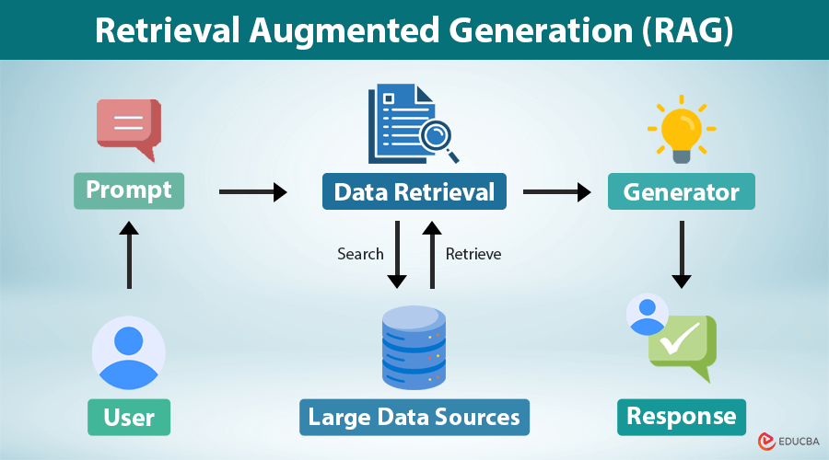
Working Principle
User query is given to the RAG system.
Retriever searches relevant information from a knowledge base.
Retrieved information is provided to the LLM as context.
LLM generates the final answer using the retrieved context.

Slide 5
Applications
Used in education for AI tutors and student assistants.
Used in healthcare for medical information retrieval.
Used in banking for customer-support chatbots.
Used in business for internal knowledge management.

Slide 6
Conclusion
RAG combines information retrieval and Generative AI to provide better answers.
It improves the accuracy, relevance, and reliability of AI-generated responses.
It allows AI systems to use updated and domain-specific information without retraining the entire model.
RAG has strong future potential in education, healthcare, banking, business, and many other fields.

Slide 7


